Slide 1
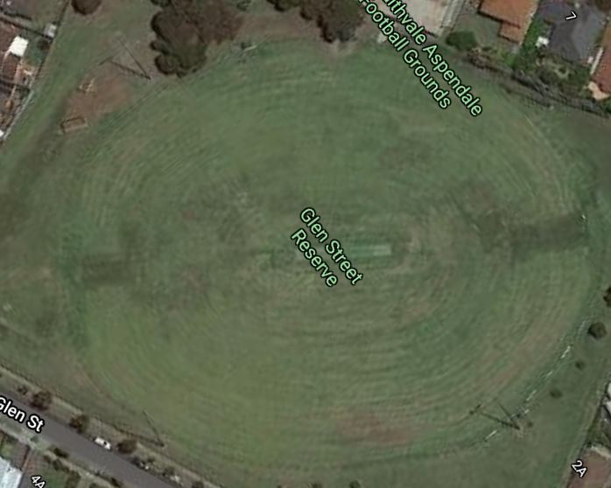
U8 & U10 Girls
Yellow Ovals (80m x 60m) with coned zones
Use goal line boundary line then cones on side to near the end of cricket pitch
Portable goal posts 5 paces apart
Padding must be installed on main ground goal posts
12 players per side and zoned
U9 & U10
Blue Oval (100m x 80m) with coned zones
Painted Blue boundary line (use cones 25m inside main oval all around if not painted)
Portable goal posts 6 paces apart
15 players per side and zoned
U11+
White Oval
Standard Ground
JMP Ground Setup 2022

